Slide 1
Chapter 5
Digital Design and Computer Architecture, 2nd Edition
David Money Harris and Sarah L. Harris

Slide 2
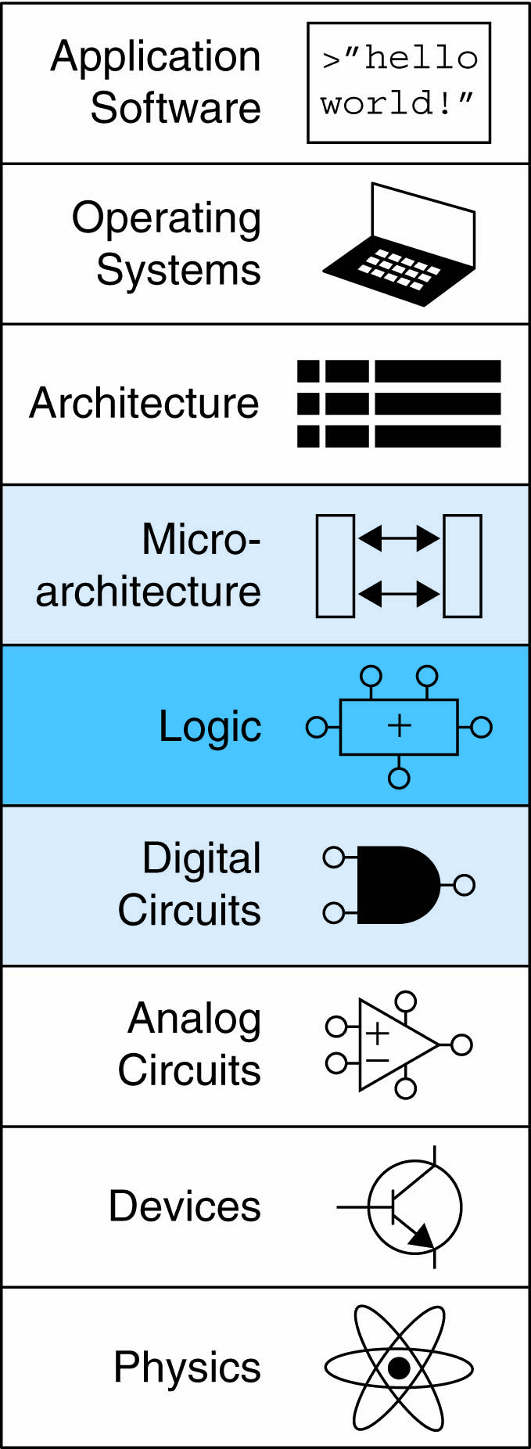
Chapter 5 :: Topics
Introduction
Arithmetic Circuits
Number Systems
Sequential Building Blocks
Memory Arrays
Logic Arrays

Slide 3
Introduction
Digital building blocks:
Gates, multiplexers, decoders, registers, arithmetic circuits, counters, memory arrays, logic arrays
Building blocks demonstrate hierarchy, modularity, and regularity:
Hierarchy of simpler components
Well-defined interfaces and functions
Regular structure easily extends to different sizes
Will use these building blocks in Chapter 7 to build microprocessor

Slide 4
1-Bit Adders

Slide 5
1-Bit Adders

Slide 6
1-Bit Adders

Slide 7
Multibit Adders (CPAs)
Types of carry propagate adders (CPAs):
Ripple-carry (slow)
Carry-lookahead (fast)
Prefix (faster)
Carry-lookahead and prefix adders faster for large adders but require more hardware
Symbol

Slide 8
Ripple-Carry Adder
Chain 1-bit adders together
Carry ripples through entire chain
Disadvantage: slow

Slide 9
Ripple-Carry Adder Delay
t_{ripple} = Nt_{FA}
where t_{FA} is the delay of a 1-bit full adder

Slide 10
Carry-Lookahead Adder
Compute carry out (C_{out}) for k-bit blocks using generate and propagate signals
Some definitions:
Column i produces a carry out by either generating a carry out or propagating a carry in to the carry out
Generate (G_{i}) and propagate (P_{i}) signals for each column:
Column i will generate a carry out if A_{i} AND B_{i} are both 1.
G_{i} = A_{i} B_{i}
Column i will propagate a carry in to the carry out if A_{i} OR B_{i} is 1.
P_{i} = A_{i} + B_{i}
The carry out of column i (C_{i}) is:
C_{i} = A_{i} B_{i} + (A_{i} + B_{i} )C_{i-1} = G_{i} + P_{i} C_{i-1}

Slide 11
Carry-Lookahead Addition
Step 1: Compute G_{i} and P_{i} for all columns
Step 2: Compute G and P for k-bit blocks
Step 3: C_{in} propagates through each k-bit propagate/generate block

Slide 12
Carry-Lookahead Adder
Example: 4-bit blocks (G_{3:0} and P_{3:0}) :
G_{3:0} = G₃ + P₃ (G₂ + P₂ (G₁ + P₁G₀ )
P_{3:0} = P₃P₂ P₁P₀
Generally,
G_{i:j} = G_{i} + P_{i} (G_{i-1} + P_{i-1} (G_{i-2} + P_{i-2}G_{j} )
P_{i:j} = P_{i}P_{i-1} P_{i-2}P_{j}
C_{i} = G_{i:j} + P_{i:j} C_{j-1}

Slide 13
32-bit CLA with 4-bit Blocks

Slide 14
Carry-Lookahead Adder Delay
For N-bit CLA with k-bit blocks:
t_{CLA} = t_{pg} + t_{pg_block} + (N/k – 1)t_{AND_OR} + kt_{FA}
t_{pg} : delay to generate all P_{i}, G_{i}
t_{pg_block} : delay to generate all P_{i:j}, G_{i:j}
t_{AND_OR} : delay from C_{in} to C_{out} of final AND/OR gate in k-bit CLA block
An N-bit carry-lookahead adder is generally much faster than a ripple-carry adder for N > 16

Slide 15
Prefix Adder
Computes carry in (C_{i-1}) for each column, then computes sum:
S_{i} = (A_{i} ⊕ B_{i}) ⊕ C_{i}
Computes G and P for 1-, 2-, 4-, 8-bit blocks, etc. until all G_{i} (carry in) known
log₂N stages

Slide 16
Prefix Adder
Carry in either generated in a column or propagated from a previous column.
Column -1 holds C_{in}, so
G₋₁ = C_{in}, P₋₁ = 0
Carry in to column i = carry out of column i-1:
C_{i-1} = G_{i-1:-1}
G_{i-1:-1}: generate signal spanning columns i-1 to -1
Sum equation:
S_{i} = (A_{i} ⊕ B_{i}) ⊕ G_{i-1:-1}
Goal: Quickly compute G_{0:-1}, G_{1:-1}, G_{2:-1}, G_{3:-1}, G_{4:-1}, G_{5:-1}, … (called prefixes)

Slide 17
Prefix Adder
Generate and propagate signals for a block spanning bits i:j:
G_{i:j} = G_{i:k} + P_{i:k} G_{k-1:j}
P_{i:j} = P_{i:k}P_{k-1:j}
In words:
Generate: block i:j will generate a carry if:
upper part (i:k) generates a carry or
upper part propagates a carry generated in lower part (k-1:j)
Propagate: block i:j will propagate a carry if both the upper and lower parts propagate the carry

Slide 18
Prefix Adder Schematic

Slide 19
Prefix Adder Delay
t_{PA} = t_{pg} + log₂N(t_{pg_prefix} ) + t_{XOR}
t_{pg}: delay to produce P_{i} G_{i} (AND or OR gate)
t_{pg_prefix}: delay of black prefix cell (AND-OR gate)

Slide 20
Adder Delay Comparisons
Compare delay of: 32-bit ripple-carry, carry-lookahead, and prefix adders
CLA has 4-bit blocks
2-input gate delay = 100 ps; full adder delay = 300 ps

Slide 21
Adder Delay Comparisons
Compare delay of: 32-bit ripple-carry, carry-lookahead, and prefix adders
CLA has 4-bit blocks
2-input gate delay = 100 ps; full adder delay = 300 ps
t_{ripple} = Nt_{FA} = 32(300 ps)
= 9.6 ns
t_{CLA} = t_{pg} + t_{pg_block} + (N/k – 1)t_{AND_OR} + kt_{FA}
= [100 + 600 + (7)200 + 4(300)] ps
= 3.3 ns
t_{PA} = t_{pg} + log₂N(t_{pg_prefix} ) + t_{XOR}
= [100 + log₂32(200) + 100] ps
= 1.2 ns

Slide 22
Subtracter

Slide 23
Comparator: Equality

Slide 24
Comparator: Less Than

Slide 25
Arithmetic Logic Unit (ALU)
F_{2:0} | Function
000 | A & B
001 | A | B
010 | A + B
011 | not used
100 | A & ~B
101 | A | ~B
110 | A - B
111 | SLT

Slide 26
ALU Design
F_{2:0} | Function
000 | A & B
001 | A | B
010 | A + B
011 | not used
100 | A & ~B
101 | A | ~B
110 | A - B
111 | SLT

Slide 27
Adder Delay Comparisons
Compare delay of: 32-bit ripple-carry, carry-lookahead, and prefix adders
CLA has 4-bit blocks
2-input gate delay = 100 ps; full adder delay = 300 ps
t_{ripple} = Nt_{FA} = 32(300 ps)
= 9.6 ns
t_{CLA} = t_{pg} + t_{pg_block} + (N/k – 1)t_{AND_OR} + kt_{FA}
= [100 + 600 + (7)200 + 4(300)] ps
= 3.3 ns
t_{PA} = t_{pg} + log₂N(t_{pg_prefix} ) + t_{XOR}
= [100 + log₂32(200) + 100] ps
= 1.2 ns

Slide 28
Set Less Than (SLT) Example
Configure 32-bit ALU for SLT operation: A = 25 and B = 32

Slide 29
Set Less Than (SLT) Example
Configure 32-bit ALU for SLT operation: A = 25 and B = 32
A < B, so Y should be 32-bit representation of 1 (0x00000001)
F_{2:0} = 111
F₂ = 1 (adder acts as subtracter), so 25 - 32 = -7
-7 has 1 in the most significant bit (S₃₁ = 1)
F_{1:0} = 11 multiplexer selects Y = S₃₁ (zero extended) = 0x00000001.

Slide 30
Shifters
Logical shifter: shifts value to left or right and fills empty spaces with 0’s
Ex: 11001 >> 2 =
Ex: 11001 << 2 =
Arithmetic shifter: same as logical shifter, but on right shift, fills empty spaces with the old most significant bit (msb).
Ex: 11001 >>> 2 =
Ex: 11001 <<< 2 =
Rotator: rotates bits in a circle, such that bits shifted off one end are shifted into the other end
Ex: 11001 ROR 2 =
Ex: 11001 ROL 2 =

Slide 31
Shifters
Logical shifter:
Ex: 11001 >> 2 = 00110
Ex: 11001 << 2 = 00100
Arithmetic shifter:
Ex: 11001 >>> 2 = 11110
Ex: 11001 <<< 2 = 00100
Rotator:
Ex: 11001 ROR 2 = 01110
Ex: 11001 ROL 2 = 00111

Slide 32
Shifter Design

Slide 33
Shifters as Multipliers, Dividers
A << N = A × 2^{N}
Example: 00001 << 2 = 00100 (1 × 2² = 4)
Example: 11101 << 2 = 10100 (-3 × 2² = -12)
A >>> N = A ÷ 2^{N}
Example: 01000 >>> 2 = 00010 (8 ÷ 2² = 2)
Example: 10000 >>> 2 = 11100 (-16 ÷ 2² = -4)

Slide 34
Multipliers
Partial products formed by multiplying a single digit of the multiplier with multiplicand
Shifted partial products summed to form result

Slide 35
4 x 4 Multiplier

Slide 36
4 x 4 Divider
A/B = Q + R/B
Algorithm:
R’ = 0
for i = N-1 to 0
R = {R’ << 1. A_{i}}
D = R - B
if D < 0, Q_{i}=0, R’=R
else Q_{i}=1, R’=D
R’=R

Slide 37
Number Systems
Numbers we can represent using binary representations
Positive numbers
Unsigned binary
Negative numbers
Two’s complement
Sign/magnitude numbers
What about fractions?

Slide 38
Numbers with Fractions
Two common notations:
Fixed-point: binary point fixed
Floating-point: binary point floats to the right of the most significant 1

Slide 39
Fixed-Point Numbers
6.75 using 4 integer bits and 4 fraction bits:
Binary point is implied
The number of integer and fraction bits must be agreed upon beforehand

Slide 40
Fixed-Point Number Example
Represent 7.5₁₀ using 4 integer bits and 4 fraction bits.

Slide 41
Fixed-Point Number Example
Represent 7.5₁₀ using 4 integer bits and 4 fraction bits.
01111000

Slide 42
Signed Fixed-Point Numbers
Representations:
Sign/magnitude
Two’s complement
Example: Represent -7.5₁₀ using 4 integer and 4 fraction bits
Sign/magnitude:
Two’s complement:

Slide 43
Signed Fixed-Point Numbers
Representations:
Sign/magnitude
Two’s complement
Example: Represent -7.5₁₀ using 4 integer and 4 fraction bits
Sign/magnitude:
11111000
Two’s complement:
1. +7.5: 01111000
2. Invert bits: 10000111
3. Add 1 to lsb: + 1
10001000

Slide 44
Floating-Point Numbers
Binary point floats to the right of the most significant 1
Similar to decimal scientific notation
For example, write 273₁₀ in scientific notation:
273 = 2.73 × 10²
In general, a number is written in scientific notation as:
± M × B^{E}
M = mantissa
B = base
E = exponent
In the example, M = 2.73, B = 10, and E = 2

Slide 45
Floating-Point Numbers
Example: represent the value 228₁₀ using a 32-bit floating point representation
We show three versions –final version is called the IEEE 754 floating-point standard

Slide 46
Floating-Point Representation 1
Convert decimal to binary (don’t reverse steps 1 & 2!):
228₁₀ = 11100100₂
Write the number in “binary scientific notation”:
11100100₂ = 1.11001₂ × 2⁷
Fill in each field of the 32-bit floating point number:
The sign bit is positive (0)
The 8 exponent bits represent the value 7
The remaining 23 bits are the mantissa

Slide 47
Floating-Point Representation 2
First bit of the mantissa is always 1:
228₁₀ = 11100100₂ = 1.11001 × 2⁷
So, no need to store it: implicit leading 1
Store just fraction bits in 23-bit field

Slide 48
Floating-Point Representation 3
Biased exponent: bias = 127 (01111111₂)
Biased exponent = bias + exponent
Exponent of 7 is stored as:
127 + 7 = 134 = 0x10000110₂
The IEEE 754 32-bit floating-point representation of 228₁₀
in hexadecimal: 0x43640000

Slide 49
Floating-Point Example
Write -58.25₁₀ in floating point (IEEE 754)

Slide 50
Floating-Point Example
Write -58.25₁₀ in floating point (IEEE 754)
Convert decimal to binary:
58.25₁₀ = 111010.01₂
Write in binary scientific notation:
1.1101001 × 2⁵
Fill in fields:
Sign bit: 1 (negative)
8 exponent bits: (127 + 5) = 132 = 10000100₂
23 fraction bits: 110 1001 0000 0000 0000 0000
in hexadecimal: 0xC2690000

Slide 51
Floating-Point: Special Cases
Number | Sign | Exponent | Fraction
0 | X | 00000000 | 00000000000000000000000
∞ | 0 | 11111111 | 00000000000000000000000
- ∞ | 1 | 11111111 | 00000000000000000000000
NaN | X | 11111111 | non-zero

Slide 52
Floating-Point Precision
Single-Precision:
32-bit
1 sign bit, 8 exponent bits, 23 fraction bits
bias = 127
Double-Precision:
64-bit
1 sign bit, 11 exponent bits, 52 fraction bits
bias = 1023

Slide 53
Floating-Point: Rounding
Overflow: number too large to be represented
Underflow: number too small to be represented
Rounding modes:
Down
Up
Toward zero
To nearest
Example: round 1.100101 (1.578125) to only 3 fraction bits
Down: 1.100
Up: 1.101
Toward zero: 1.100
To nearest: 1.101 (1.625 is closer to 1.578125 than 1.5 is)

Slide 54
Floating-Point Addition
Extract exponent and fraction bits
Prepend leading 1 to form mantissa
Compare exponents
Shift smaller mantissa if necessary
Add mantissas
Normalize mantissa and adjust exponent if necessary
Round result
Assemble exponent and fraction back into floating-point format

Slide 55
Floating-Point Addition Example
Add the following floating-point numbers:
0x3FC00000
0x40500000

Slide 56
Floating-Point Addition Example
1. Extract exponent and fraction bits
For first number (N1): S = 0, E = 127, F = .1
For second number (N2): S = 0, E = 128, F = .101
2. Prepend leading 1 to form mantissa
N1: 1.1
N2: 1.101

Slide 57
Floating-Point Addition Example
3. Compare exponents
127 – 128 = -1, so shift N1 right by 1 bit
4. Shift smaller mantissa if necessary
shift N1’s mantissa: 1.1 >> 1 = 0.11 (× 2¹)
5. Add mantissas
0.11 × 2¹
+ 1.101 × 2¹
10.011 × 2¹

Slide 58
Floating Point Addition Example
6. Normalize mantissa and adjust exponent if necessary
10.011 × 2¹ = 1.0011 × 2²
7. Round result
No need (fits in 23 bits)
8. Assemble exponent and fraction back into floating-point format
S = 0, E = 2 + 127 = 129 = 10000001₂, F = 001100..
in hexadecimal: 0x40980000

Slide 59
Counters
Increments on each clock edge
Used to cycle through numbers. For example,
000, 001, 010, 011, 100, 101, 110, 111, 000, 001…
Example uses:
Digital clock displays
Program counter: keeps track of current instruction executing

Slide 60
Shift Registers
Shift a new bit in on each clock edge
Shift a bit out on each clock edge
Serial-to-parallel converter: converts serial input (S_{in}) to parallel output (Q_{0:N-1})
Symbol:
Implementation:

Slide 61
Shift Register with Parallel Load
When Load = 1, acts as a normal N-bit register
When Load = 0, acts as a shift register
Now can act as a serial-to-parallel converter (S_{in} to Q_{0:N-1}) or a parallel-to-serial converter (D_{0:N-1} to S_{out})

Slide 62
Memory Arrays
Efficiently store large amounts of data
3 common types:
Dynamic random access memory (DRAM)
Static random access memory (SRAM)
Read only memory (ROM)
M-bit data value read/ written at each unique N-bit address

Slide 63
Memory Arrays
2-dimensional array of bit cells
Each bit cell stores one bit
N address bits and M data bits:
2^{N} rows and M columns
Depth: number of rows (number of words)
Width: number of columns (size of word)
Array size: depth × width = 2^{N} × M

Slide 64
Memory Array Example
2² × 3-bit array
Number of words: 4
Word size: 3-bits
For example, the 3-bit word stored at address 10 is 100

Slide 65
Memory Arrays

Slide 66
Memory Array Bit Cells

Slide 67
Memory Array Bit Cells
0
Z
1
Z

Slide 68
Memory Array
Wordline:
like an enable
single row in memory array read/written
corresponds to unique address
only one wordline HIGH at once

Slide 69
Types of Memory
Random access memory (RAM): volatile
Read only memory (ROM): nonvolatile

Slide 70
RAM: Random Access Memory
Volatile: loses its data when power off
Read and written quickly
Main memory in your computer is RAM (DRAM)
Historically called random access memory because any data word accessed as easily as any other (in contrast to sequential access memories such as a tape recorder)

Slide 71
ROM: Read Only Memory
Nonvolatile: retains data when power off
Read quickly, but writing is impossible or slow
Flash memory in cameras, thumb drives, and digital cameras are all ROMs
Historically called read only memory because ROMs were written at manufacturing time or by burning fuses. Once ROM was configured, it could not be written again. This is no longer the case for Flash memory and other types of ROMs.

Slide 72
Types of RAM
DRAM (Dynamic random access memory)
SRAM (Static random access memory)
Differ in how they store data:
DRAM uses a capacitor
SRAM uses cross-coupled inverters

Slide 73
Robert Dennard, 1932 -
Invented DRAM in 1966 at IBM
Others were skeptical that the idea would work
By the mid-1970’s DRAM in virtually all computers

Slide 74
DRAM
Data bits stored on capacitor
Dynamic because the value needs to be refreshed (rewritten) periodically and after read:
Charge leakage from the capacitor degrades the value
Reading destroys the stored value

Slide 75
DRAM

Slide 76
SRAM

Slide 77
Memory Arrays Review
DRAM bit cell:
SRAM bit cell:

Slide 78
ROM: Dot Notation

Slide 79

Fujio Masuoka, 1944 -
Developed memories and high speed circuits at Toshiba, 1971-1994
Invented Flash memory as an unauthorized project pursued during nights and weekends in the late 1970’s
The process of erasing the memory reminded him of the flash of a camera
Toshiba slow to commercialize the idea; Intel was first to market in 1988
Flash has grown into a $25 billion per year market

Slide 80
ROM Storage

Slide 81
ROM Logic
Data₂ = A₁ ⊕ A₀
Data₁ = A₁ + A₀
Data₀ = A₁A₀

Slide 82
Example: Logic with ROMs
Implement the following logic functions using a 2² × 3-bit ROM:
X = AB
Y = A + B
Z = A B

Slide 83
Example: Logic with ROMs
Implement the following logic functions using a 2² × 3-bit ROM:
X = AB
Y = A + B
Z = A B

Slide 84
Logic with Any Memory Array
Data₂ = A₁ ⊕ A₀
Data₁ = A₁ + A₀
Data₀ = A₁A₀

Slide 85
Logic with Memory Arrays
Implement the following logic functions using a 2² × 3-bit memory array:
X = AB
Y = A + B
Z = A B

Slide 86
Logic with Memory Arrays
Implement the following logic functions using a 2² × 3-bit memory array:
X = AB
Y = A + B
Z = A B

Slide 87
Logic with Memory Arrays
Called lookup tables (LUTs): look up output at each input combination (address)

Slide 88
Multi-ported Memories
Port: address/data pair
3-ported memory
2 read ports (A1/RD1, A2/RD2)
1 write port (A3/WD3, WE3 enables writing)
Register file: small multi-ported memory

Slide 89
SystemVerilog Memory Arrays
// 256 x 3 memory module with one read/write port
module dmem( input logic clk, we,
input logic [7:0] a,
input logic [2:0] wd,
output logic [2:0] rd);
logic [2:0] RAM[255:0];
assign rd = RAM[a];
always @(posedge clk)
if (we)
RAM[a] <= wd;
endmodule

Slide 90
Logic Arrays
PLAs (Programmable logic arrays)
AND array followed by OR array
Combinational logic only
Fixed internal connections
FPGAs (Field programmable gate arrays)
Array of Logic Elements (LEs)
Combinational and sequential logic
Programmable internal connections

Slide 91
PLAs
X = ABC + ABC
Y = AB

Slide 92
PLAs: Dot Notation

Slide 93
FPGA: Field Programmable Gate Array
Composed of:
LEs (Logic elements): perform logic
IOEs (Input/output elements): interface with outside world
Programmable interconnection: connect LEs and IOEs
Some FPGAs include other building blocks such as multipliers and RAMs

Slide 94
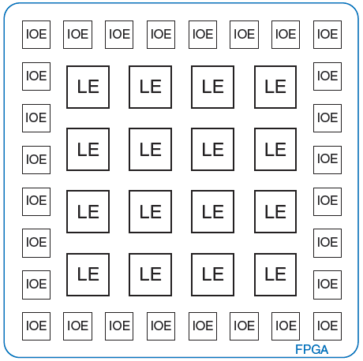
General FPGA Layout

Slide 95
LE: Logic Element
Composed of:
LUTs (lookup tables): perform combinational logic
Flip-flops: perform sequential logic
Multiplexers: connect LUTs and flip-flops

Slide 96
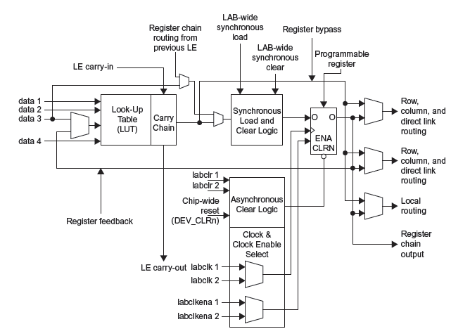
Altera Cyclone IV LE

Slide 97
Altera Cyclone IV LE
The Altera Cyclone IV LE has:
1 four-input LUT
1 registered output
1 combinational output

Slide 98
LE Configuration Example
Show how to configure a Cyclone IV LE to perform the following functions:
X = ABC + ABC
Y = AB

Slide 99
LE Configuration Example
Show how to configure a Cyclone IV LE to perform the following functions:
X = ABC + ABC
Y = AB

Slide 100
FPGA Design Flow
Using a CAD tool (such as Altera’s Quartus II)
Enter the design using schematic entry or an HDL
Simulate the design
Synthesize design and map it onto FPGA
Download the configuration onto the FPGA
Test the design

